Slide 1

N_class=5500 (500,1000:500:5500)
N_class(1)=500
N = 6000
Deltax=0.1
N_temp: ^2 → ^4 && 1e7→1e6
Mass Sample in „SAL.m“: Rate 1.2→1.1

Slide 2
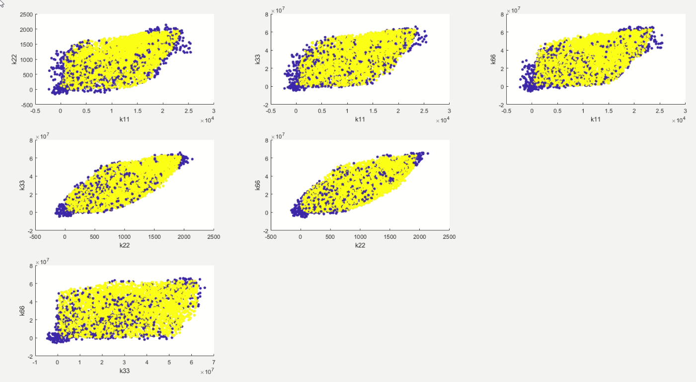
Alle Classifikation Samples

Slide 3
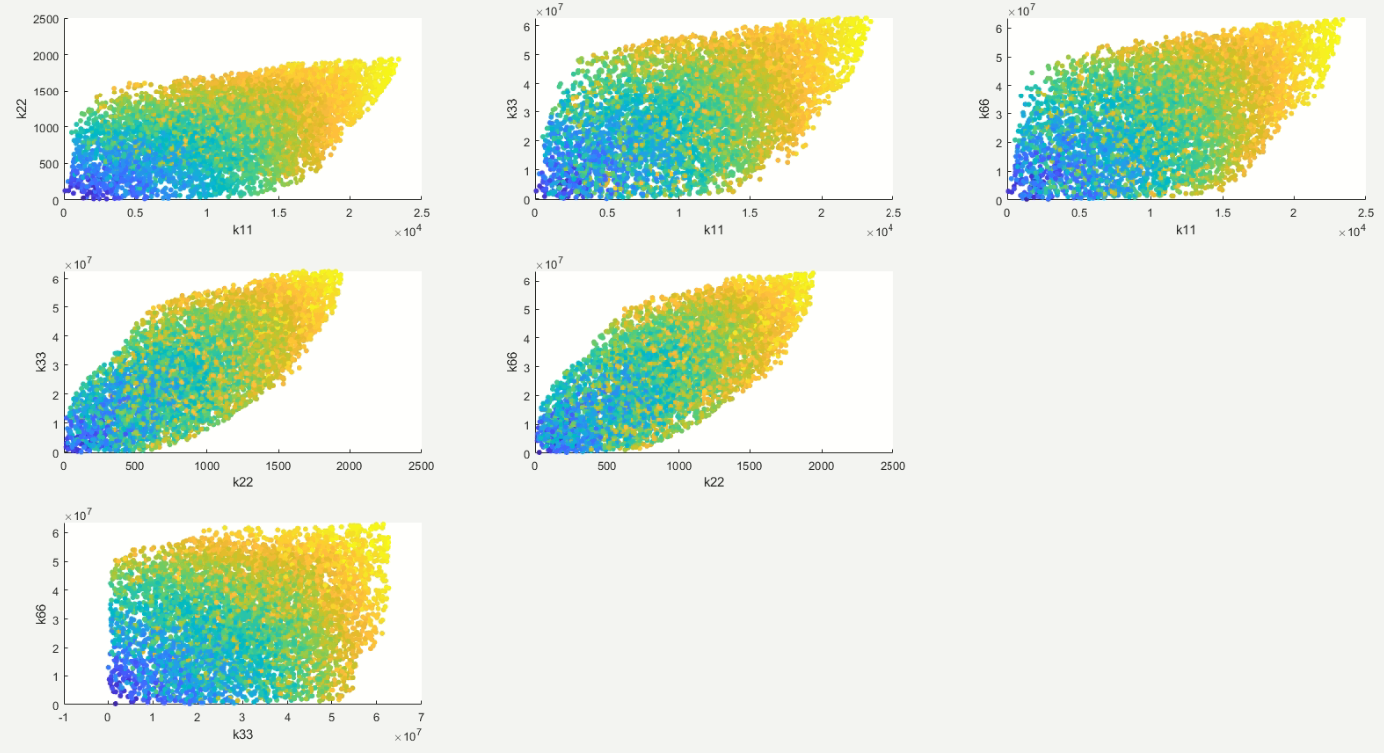
Alle Mass Samples

Slide 4
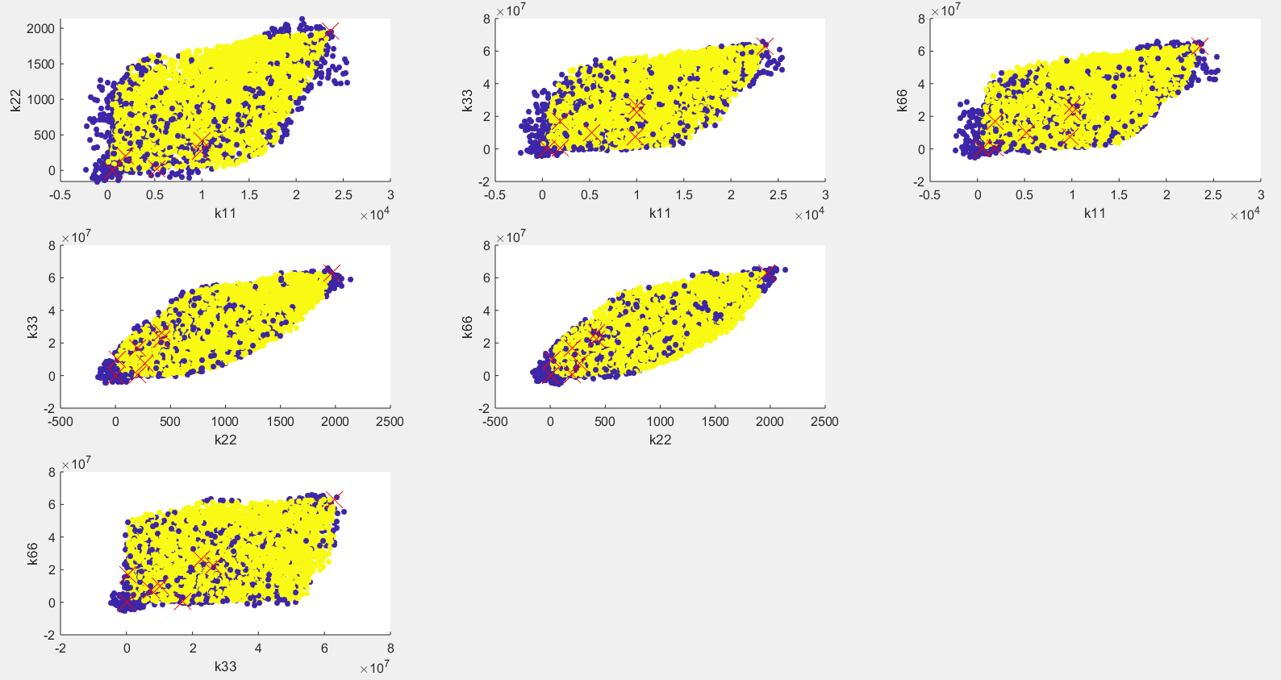

Slide 5
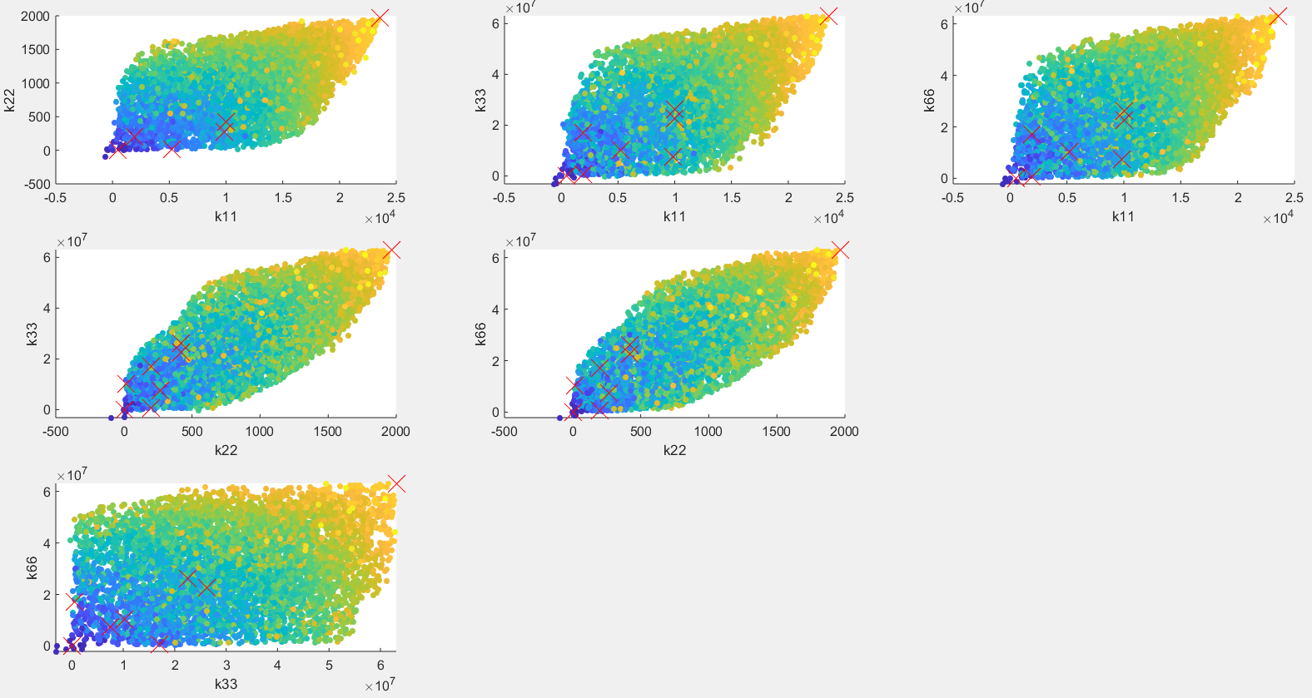

Slide 6
2D: 6 Lastfallen
Schwarz für optimale Kappa-Vektor nach „M_O.m“; Rot für optimale Kappa-Vektor nach „C_O.m“
Kraft/ Fload | Verschiebung | Richtung/ (x/y/r) | K11_ Komp1 | K22_ Komp1 | K33_ Komp1 | K66_ Komp1 | m1 | K11_ Komp2 | K22_ Komp2 | K33_ Komp2 | K66_ Komp2 | m2
49.03 | 1 | y | 1.0031e+04 | 418.4683 | 2.6274e+07 | 2.2549e+07 | 58.7521 | 1.8983e+03 | 197.0604 | 1.7008e+07 | 4.9670e+05 | 39.2954
→Nach „C.O.m“ |  |  | 9.9297e+03 | 422.6876 | 2.6010e+07 | 2.2324e+07 | 57.7815 | 1.8796e+03 | 199.0337 | 1.6838e+07 | 4.9175e+05 | 39.1609
49.03 *5 | 1 | x | 490.4250 | 1.6118 | 6.3635e+04 | 6.3635e+04 | 18.7854 | 490.4250 | 1.6118 | 6.3635e+04 | 6.3635e+04 | 18.7854
→Nach „C.O.m“ |  |  | 485.5156 | 1.5957 | 6.4270e+04 | 6.4273e+04 | 20.2275 | 485.5156 | 1.5957 | 6.4270e+04 | 6.4273e+04 | 20.2275
49.03 *400 | 1 | x | 2.3583e+04 | 1.9648e+03 | 6.3075e+07 | 6.3075e+07 | 100.0000 | 2.3583e+04 | 1.9648e+03 | 6.3075e+07 | 6.3075e+07 | 100.0000
→Nach „C.O.m“ |  |  | 2.3347e+04 | 1.9452e+03 | 6.2444e+07 | 6.2444e+07 | 99.6510 | 2.3347e+04 | 1.9452e+03 | 6.2444e+07 | 6.2444e+07 | 99.6510
49.03 | 1 *0.01 | x | 9.8243e+03 | 267.5714 | 7.4919e+06 | 7.4919e+06 | 48.9162 | 9.7890e+03 | 267.4561 | 7.4884e+06 | 7.4886e+06 | 48.8667
→Nach „C.O.m“ |  |  | 9.7261e+03 | 264.8996 | 7.4350e+06 | 7.4350e+06 | 49.2105 | 9.7261e+03 | 264.8996 | 7.4350e+06 | 7.4350e+06 | 49.2105
49.03 | 1 *0.00001 | r | 5.2144e+03 | 16.1190 | 1.0169e+07 | 1.0169e+07 | 34.3127 | 5.2144e+03 | 16.1190 | 1.0169e+07 | 1.0169e+07 | 34.3127
→Nach „C.O.m“ |  |  | 5.1623e+03 | 15.9579 | 1.0067e+07 | 1.0140e+07 | 34.0497 | 5.1623e+03 | 15.9579 | 1.0067e+07 | 1.0140e+07 | 34.0497
49.03 | 1 | y_l | 1.8984e+03 | 197.0597 | 4.9667e+05 | 1.7008e+07 | 39.2956 | 1.0031e+04 | 418.4884 | 2.2550e+07 | 2.6274e+07 | 58.7516
→Nach „C.O.m“ |  |  | 1.8794e+03 | 199.0308 | 4.9170e+05 | 1.6838e+07 | 39.1615 | 9.9307e+03 | 422.6736 | 2.2325e+07 | 2.6011e+07 | 57.7861

Slide 7
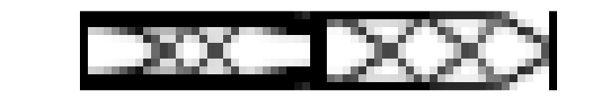
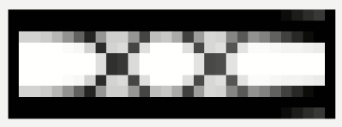
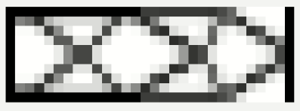
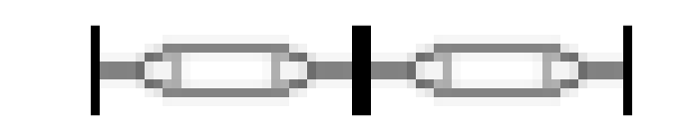
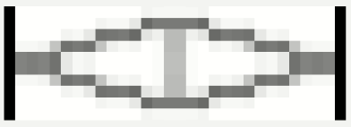


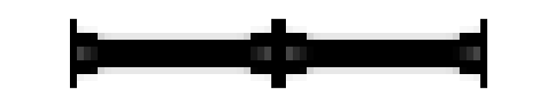

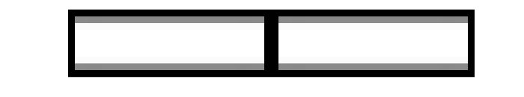
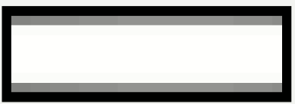
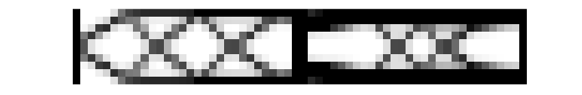



Slide 8
6 Lastfallen
Rot für optimale Kappa-Vektor nach „C_O.m“; Blue für geschätzt Kappa_Vektor nach „C.O.m“
Kraft/ Fload | Verschiebung | Richtung/ (x/y/r) | K11_ Komp1 | K22_ Komp1 | K33_ Komp1 | K66_ Komp1 | m1 | K11_ Komp2 | K22_ Komp2 | K33_ Komp2 | K66_ Komp2 | m2
49.03 | 1 | y | 9.9297e+03 | 422.6876 | 2.6010e+07 | 2.2324e+07 | 57.7815 | 1.8796e+03 | 199.0337 | 1.6838e+07 | 4.9175e+05 | 39.1609
→geschätzt Ergebnis |  |  | 8.7502e+03 | 404.0366 | 2.6274e+07 | 1.8212e+07 | 55.2039 | 3.3199e+03 | 246.0695 | 1.9482e+07 | 1.3590e+06 | 41.8000
49.03 *5 | 1 | x | 485.5156 | 1.5957 | 6.4270e+04 | 6.4273e+04 | 20.2275 | 485.5156 | 1.5957 | 6.4270e+04 | 6.4273e+04 | 20.2275
→geschätzt Ergebnis |  |  | 2.1331e+03 | 6.7222 | 1.3199e+06 | 1.7573e+06 | 25.3621 | 2.1954e+03 | 6.3419 | 1.4197e+06 | 1.7610e+06 | 26.5483
49.03 *400 | 1 | x | 2.3347e+04 | 1.9452e+03 | 6.2444e+07 | 6.2444e+07 | 99.6510 | 2.3347e+04 | 1.9452e+03 | 6.2444e+07 | 6.2444e+07 | 99.6510
→geschätzt Ergebnis |  |  | 2.3424e+04 | 1.9290e+03 | 6.2187e+07 | 6.1780e+07 | 99.7579 | 2.3424e+04 | 1.9291e+03 | 6.2187e+07 | 6.1780e+07 | 99.7579
49.03 | 1 *0.01 | x | 9.7261e+03 | 264.8996 | 7.4350e+06 | 7.4350e+06 | 49.2105 | 9.7261e+03 | 264.8996 | 7.4350e+06 | 7.4350e+06 | 49.2105
→geschätzt Ergebnis |  |  | 9.7309e+03 | 291.5527 | 1.6431e+07 | 3.8271e+06 | 53.2800 | 9.6658e+03 | 284.3684 | 1.6654e+07 | 3.7821e+06 | 52.5533
49.03 | 1 *0.00001 | r | 5.1623e+03 | 15.9579 | 1.0067e+07 | 1.0140e+07 | 34.0497 | 5.1623e+03 | 15.9579 | 1.0067e+07 | 1.0140e+07 | 34.0497
→geschätzt Ergebnis |  |  | 5.2783e+03 | 205.3860 | 1.5337e+07 | 1.3724e+07 | 41.2035 | 5.3782e+03 | 45.5337 | 1.1449e+07 | 1.0468e+07 | 35.9390
49.03 | 1 | y_l | 1.8794e+03 | 199.0308 | 4.9170e+05 | 1.6838e+07 | 39.1615 | 9.9307e+03 | 422.6736 | 2.2325e+07 | 2.6011e+07 | 57.7861
→geschätzt Ergebnis |  |  | 2.4120e+03 | 208.0058 | 1.0856e+06 | 1.6721e+07 | 39.5148 | 9.3467e+03 | 550.9149 | 2.3226e+07 | 2.9542e+07 | 58.8709

Slide 9


